Slide 1
Senior cloud engineer case study
Zhing hang Lee

Slide 2
Introduction
Design cloud infrastructure to automate recipe process.
Process including storage, consolidation, and distribution.
Goal: Send zip-archive recipe from storage to global user securely.

Slide 3
REQUIREMENTS
• Storage: Handle large & small file at scale that includes version control.
• Consolidation: Compress into single zip-archive file and store securely.
• Distribution: Securely distribute globally with access control.
• Network: VPN connection between on-prem and cloud.
• Security: Data encryption at rest & in-transit.

Slide 4
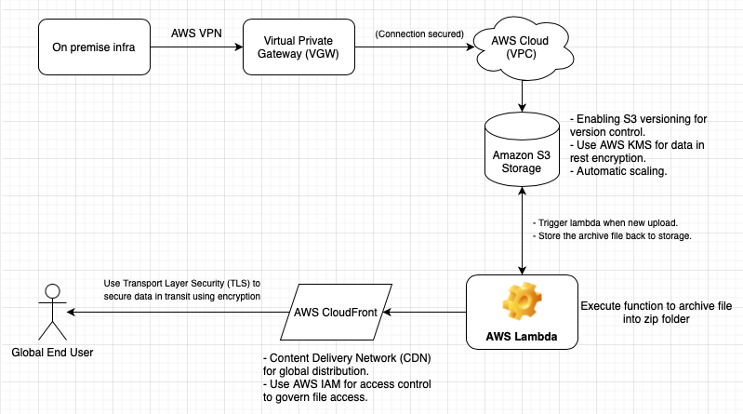
High-level Architecture Diagram

Slide 5
Explanation of each component (AWS Cloud Services)
Storage - AWS S3 Storage :
Serverless, scale automatically for large & small files.
S3 Versioning - version control to track changes.
Consolidation - AWS Lambda:
Automate the process of zipping files.
Trigger the function when new files are uploaded to the storage.
Distribution – AWS CloudFront:
Distribute the zipped files globally with low latency.
Use tokens for access control.

Slide 6
Network - AWS VPN:
Establish a secure connection between on-premises and cloud infrastructure.
AWS Site-to-Site VPN creates encrypted connections.
Security - AWS KMS & IAM:
Manage encryption keys for data at rest in S3.
Use TLS for data in transit.
Identity-based policies, policies action for service access in Lambda & CloudFront.

Slide 7
IaC template
Refer to YAML file

Slide 8
INSIGHT ON KEY TOPICS (Benefit, Pitfall, Consideration)
Infrastructure as Code (IaC)
Benefits:
Consistency: eliminate manual errors, repeatable deployments.
Speed: Automates provisioning, reducing setup time.
Version control: track changes, perform rollback when failure.
Pitfall:
Complexity: Challenging & difficult for large-scale infrastructure.
Security risk: misconfiguration may cause vulnerabilities.
Learning curve: May require new skills and tool (Different from programming)
Consideration:
Tool selection: AWS CloudFormation / Terraform.
Test & validate: Test script before deployment.
Collaborate: Include dev, ops and security team.

Slide 9
IoT and Edge computing
Benefits:
Fast Decisions: Devices process data right where it’s created—no waiting for the cloud.
Less Internet Traffic: Only important data goes to the cloud, saving bandwidth.
Saves Money: Less cloud usage = lower costs.
Pitfall:
Security Risks: IoT devices can be easy targets for hackers.
Too Many Devices: Managing thousands of devices can get messy.
Privacy Issues: Collecting data locally can raise privacy concerns.
Key Considerations
Secure Devices: Use strong passwords and encryption.
Plan for Data: Decide what to process locally vs. sending to the cloud.
Follow Rules: Make sure you’re compliant with privacy laws (e.g., GDPR).

Slide 10
Cost calculations and optimisations
Benefit:
Better resource management: pay for what you use service.
Cost saving from rightsizing: prevent over/under provisioning.
Predictability and budgeting: Cost management tools that help estimate future cost spending.
Pitfall:
Complex pricing model: different price charges for different services (storage, compute, etc)
Underestimating/overestimating: overestimate cause unnecessary cost, underestimate cause performance issue
Over-optimizing for cost: Focus too much on cost result in poor performance and quality.
Consideration:
Monitor resources : monitor resource regularly and adjust accordingly.
Storage optimization: choose right storage plan / archive old data can save money.
Compute optimization: choose reserved instance / commitment plan if plan to use for a longer period.

Slide 11
THANK YOU

